Slide 1
ADULT CHRISTIAN FORMATION
Diocesan Migration Ministry Resources, Week 1 Presentation
Reprinted with permission by

Slide 2
ADULT CHRISTIAN FORMATION
Opening Prayer
A Collect for Refugees
Holy One of Bethlehem,
From your earliest days you knew the threat of death, the terror of flight, and the pain of exile.
Today we know that so many – millions upon millions -
Flee for their own lives and for their children.
The numbers seem so vast, the problem so great.
It is easy to feel helpless. It is easy to forget. It is easy to ignore.
Shake us from complacency and from resignation.
Fill our hearts and minds with understanding and compassion for your children
Who are forced by persecution and fear to flee their homes.
Remind us that each number is a name, each statistic a person -
Your child, your beloved.
Strengthen our resolve; stir in us a spirit of agency and action.
For you have blessed each of us with gifts to be shared in love for all you have created,
Gifts that may be used to welcome, to comfort, to befriend.
Grant that we would listen for your call.
In Your Holy Name we pray, Amen.

Slide 3
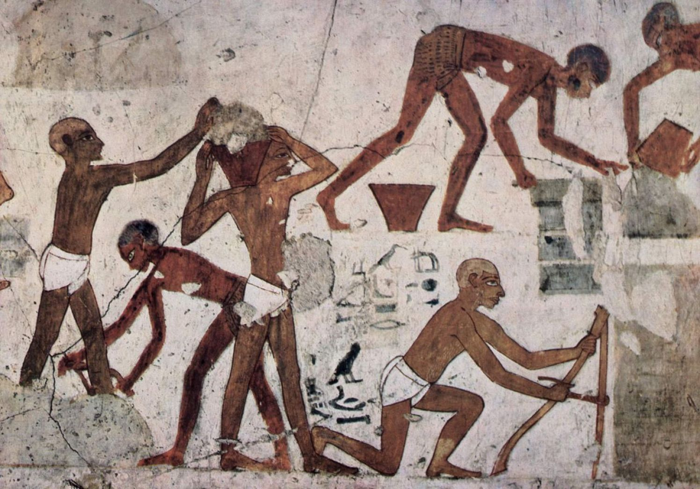
ADULT CHRISTIAN FORMATION
Human Migration
The tomb of Egyptian vizier Rekhimire, ca. 1450 BCE, shows foreign slaves “making bricks for the workshop-storeplace of the Temple of Amun at Karnak in Thebes” and for a building ramp.
Source: Wikimedia Commons
More: https://www.haaretz.com/jewish/archaeology/1.713849
Notes:
In the Abrahamic faith traditions, we have inherited the stories of our spiritual forebears, ancestors whom we know were often driven to migration, and rarely by benign circumstances.

Slide 4
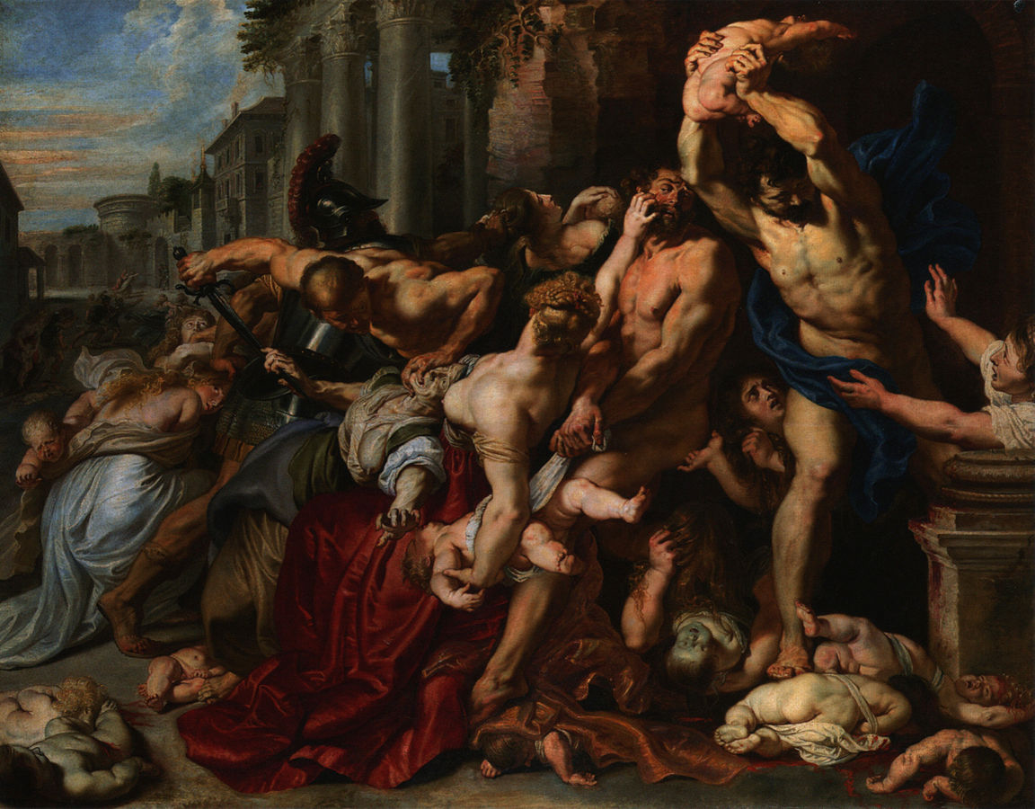
ADULT CHRISTIAN FORMATION
Human Migration
The Massacre of the Innocents, 1611
Peter Paul Rubens
(1577-1640)
Oil on oak
Art Gallery of Ontario
Notes:
Bondage, famine, persecution and violence drove our forebears to leave their homes and everything they knew to set out into the unknown.
From Moses’ leading the Israelites out of bondage in Egypt to the flight of the Holy Family from Palestine to Egypt to escape the wrath of King Herod: the foundational narratives of the Abrahamic traditions are stories of migration - people on the move and those who welcome or deny them.

Slide 5
ADULT CHRISTIAN FORMATION
Forced Migration
How do we respond?
Notes:
Indeed, these stories are not relics from some distant past; they are being lived, today, and we’re all characters. More than 20 million have no choice in which role they play: they’ve been forced to flee for their lives. The rest of us… we have questions to answer. Do we welcome? Are we bystanders? Or are we culpable and complicit? How will we write the story?
The Episcopal Church has long answered these questions by choosing to welcome through resettlement.

Slide 6
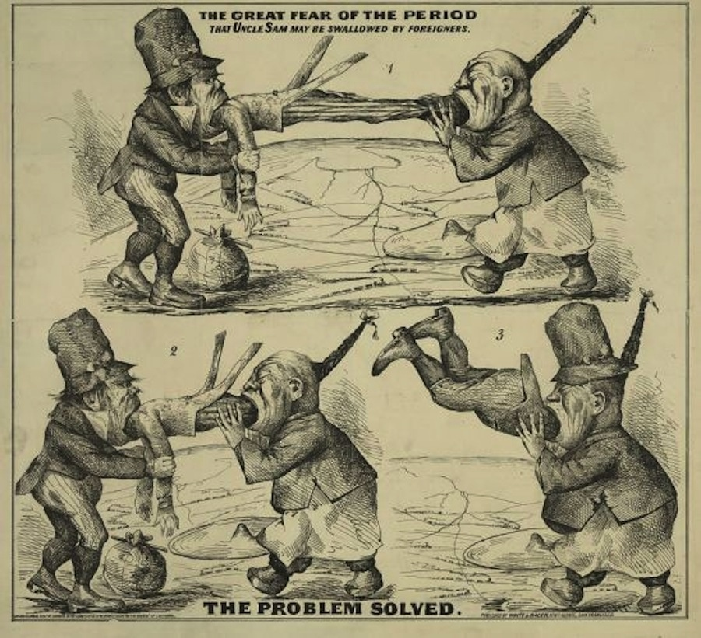
ADULT CHRISTIAN FORMATION
Historical Context: Immigration Restrictionism in the U.S.
Problem Solved
An Irishman and a Chinese man devour Uncle Sam. Then the Chinese man eats the Irishman and steals his hat.
Caption reads: “The Great Fear of the Period: That Uncle Sam may be Swallowed by Foreigners.”
Image: Library of Congress
Notes:
Our formal work began in the 1930’s, against a backdrop of immigration restrictionism at home and the rise of the Nazi party in Europe.

Slide 7
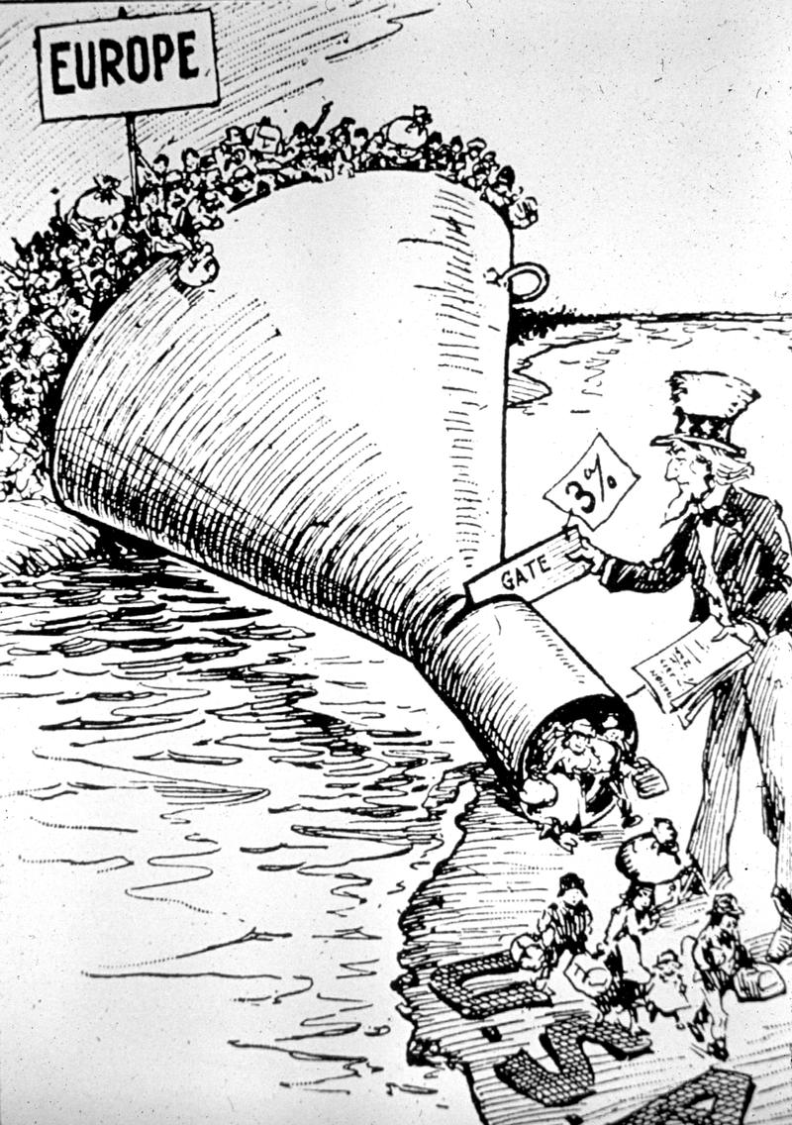
ADULT CHRISTIAN FORMATION
Historical Context: Immigration Restrictionism in the U.S.
Emergency Quota Act of 1921
Cartoon depicts Uncle Sam implementing the Emergency Quota Act, which limited the annual number of immigrants admitted from any country to 3% of the number of persons from that country already living in the United States according to the census of 1910.
National Origins Formula of 1929
Capped immigration at 150,000 annually and barred all Asian immigration.
Notes:
Horrifying news of the Jewish refugee crisis in Europe began hitting American newspapers.
At that time, Bishop Henry Hobson, then bishop of the Episcopal Diocese of Southern Ohio, said:

Slide 8
ADULT CHRISTIAN FORMATION
Historical Context: The Church’s Response
“As Christians, we can only take one stand… We can act as sponsors for individuals or families [fleeing Germany]; we can sign the necessary affidavits so that these refugees can be admitted under the quota; we can give generously for their maintenance and relief; we can stand firmly in opposition to the voice of the devil heard in the anti-Semitic propaganda which is such an insidious evil in our midst; we can show a willingness to make a real sacrifice, without whimpering, as we show forth Christ’s love for these great sufferers of our day.”
– The Rt. Rev. Henry W. Hobson, II, Diocese of Southern Ohio (Bishop of Southern Ohio from 1930 to 1959)
Notes:
“As Christians, we can only take one stand… We can act as sponsors for individuals or families [fleeing Germany]; we can sign the necessary affidavits so that these refugees can be admitted under the quota; we can give generously for their maintenance and relief; we can stand firmly in opposition to the voice of the devil heard in the anti-Semitic propaganda which is such an insidious evil in our midst; we can show a willingness to make a real sacrifice, without whimpering, as we show forth Christ’s love for these great sufferers of our day.”

Slide 9
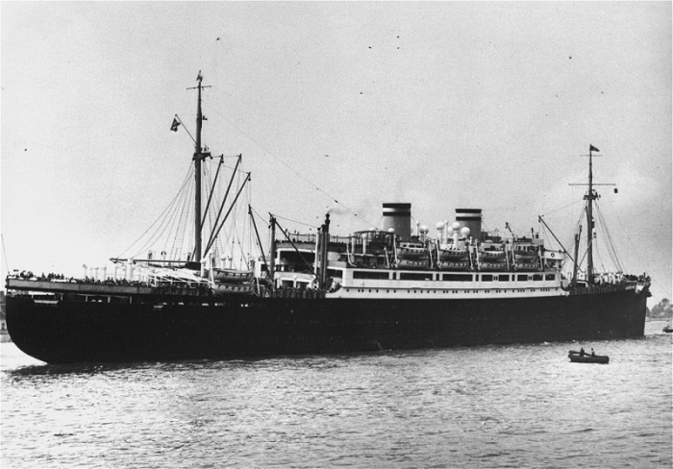
EPIPHANY 2018 ADULT CHRISTIAN FORMATION
The "St. Louis," carrying Jewish refugees from Nazi Germany, arrives in the port of Antwerp after Cuba and the United States denied it landing. Belgium, June 17, 1939. — Bibliotheque Historique de la Ville de Paris | Website of the US Holocaust Memorial Museum
Notes:
In 1939, the same year that MS St. Louis ocean liner, carrying over 900 Jewish refugees, was turned away from Miami, the Diocese of Southern Ohio published this iconic poster –

Slide 10
ADULT CHRISTIAN FORMATION
From Past to Present: The Church’s Response
Matthew 2:13-23
Notes:
“In the name of these refugees, aid all refugees,” depicting the Holy Family - Jesus and his parents - fleeing to Egypt to escape the persecution of King Herod, which is found in the Gospel of Matthew, chapter 2. It became a rallying cry across the church. Parishes and dioceses all across the country joined the effort, speaking out on behalf Jewish refugees and others displaced by the Nazis.
[same slide – click space bar/mouse again and let play] Decades later, out of these efforts, Episcopal Migration Ministries, the Church’s ministry of refugee resettlement and welcome, was born. Today, Episcopal Migration Ministries is both one of the ten national refugee resettlement agencies that works in public-private partnership with the government to resettle refugees, as well as a growing ministry of The Episcopal Church focused on the refugee welcoming movement.

Slide 11
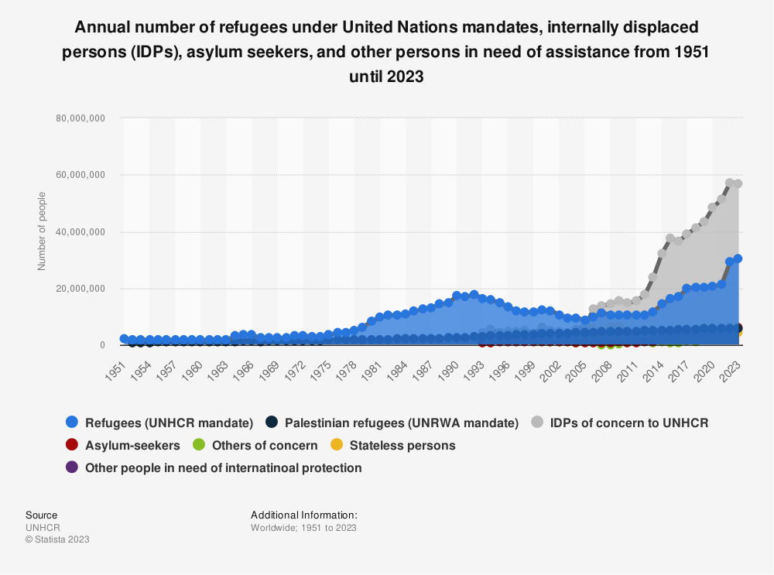
ADULT CHRISTIAN FORMATION
Global Refugee Crisis
Notes:
Since the 1950s, the number of forcibly displaced persons recognized by the United Nations has increased drastically; from around 2.1 million international refugees in 1951 to some 110 million displaced persons in total in 2023.
The United Nations High Commissioner for Refugees (UNHCR) was founded in 1950 to deal with the large number of displaced persons in Europe in the aftermath of the Second World War. Since then, the scale and geographical scope of its operations has broadened significantly, as it works to provide humanitarian aid, logistical support, and long-term solutions to crises across the globe. Alongside the UNHCR, the United Nations Relief and Works Agency (UNRWA) was established in 1949 to provide similar assistance programs for Palestinian refugees and their descendants, and it is currently operational in Jordan, Lebanon, Syria, and Palestine.

Slide 12
ADULT CHRISTIAN FORMATION
Definitions
Notes:
The word refugee has a particular and important definition in international law, coming out of the 1951 Geneva Convention and Protocols relating to the Status of Refugees, instruments that arose during the refugee crisis caused by WWII.
I’ll read the Convention definition, and then we’ll break it down. A “Refugee” is an individual who:
“...owing to well-founded fear of being persecuted for reasons of race, religion, nationality, membership of a particular social group or political opinion, is outside the country of his nationality and is unable or, owing to such fear, is unwilling to avail himself of the protection of that country...]

Slide 13
ADULT CHRISTIAN FORMATION
Definitions
Refugee
Asylum-seeker
Internally displaced persons (IDP’s)
Notes:
Refugees are those who were forced to flee across an international border to seek protection in another country, because their governments are unwilling or unable to protect them. Before these individuals receive official refugee status, they are known as asylum-seekers. They have left their country of origin and are seeking safety – asylum – in another country.
War, conflict, and persecution displaces many millions more than those who are able to cross a border. The United Nations estimates that among the 110 million people displaced worldwide today, about one third are refugees, and about 5% are asylum seekers. The remainder are those who are displaced within the borders of their own country. They are known, in international law, as internally displaced persons (IDP’s), and are often in far more vulnerable and dangerous situations than refugees.

Slide 14
ADULT CHRISTIAN FORMATION
Definitions
Refugees
Asylum-seekers
Internally displaced persons (IDP’s)
Other forcibly displaced people in need of international protection
Source: UNHCR Mid-Year Trends, 2023
Notes:
In addition to refugees, asylum-seekers and internally displaced persons (IDPs), the UNHCR recognizes and tries to assist other categories of forcibly displaced people, such as the over 5 million who have fled from Venezuela to Colombia and other countries, due to political strife, human rights abuses and extreme poverty. The figure of 110 million forcibly displaced people in the world in mid-2023 reflects what is known about all four of these categories. These figures do not include the millions of people displaced from their homes in Gaza in the on-going war between Israel and Hamas. For various reasons, Palestinian refugees are counted and served separately, under the mandate of the U.N.R.W.A. (United Nations Relief and Works Agency for Palestine Refugees in the Near East). Suffice it to say that the number of people forcibly displaced from their homes due to conflict, persecution, climate change, and/or other factors continues to grow.

Slide 15
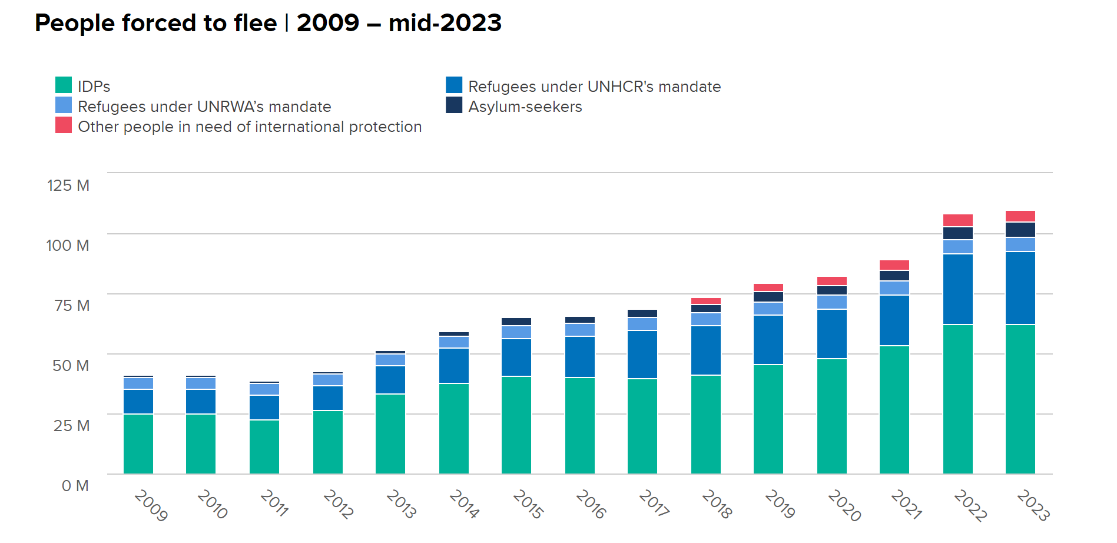
ADULT CHRISTIAN FORMATION
Global Crisis
Source: UNHCR Mid-Year Trends 2023, p. 9
Notes:
Here is another way to look at the increases in the numbers of forcibly displaced people, from 2009 until June 2023. There have been increases in all categories of displaced persons over the past dozen or so years, including IDPs, asylum seekers, refugees, and other people in need of international protection.

Slide 16
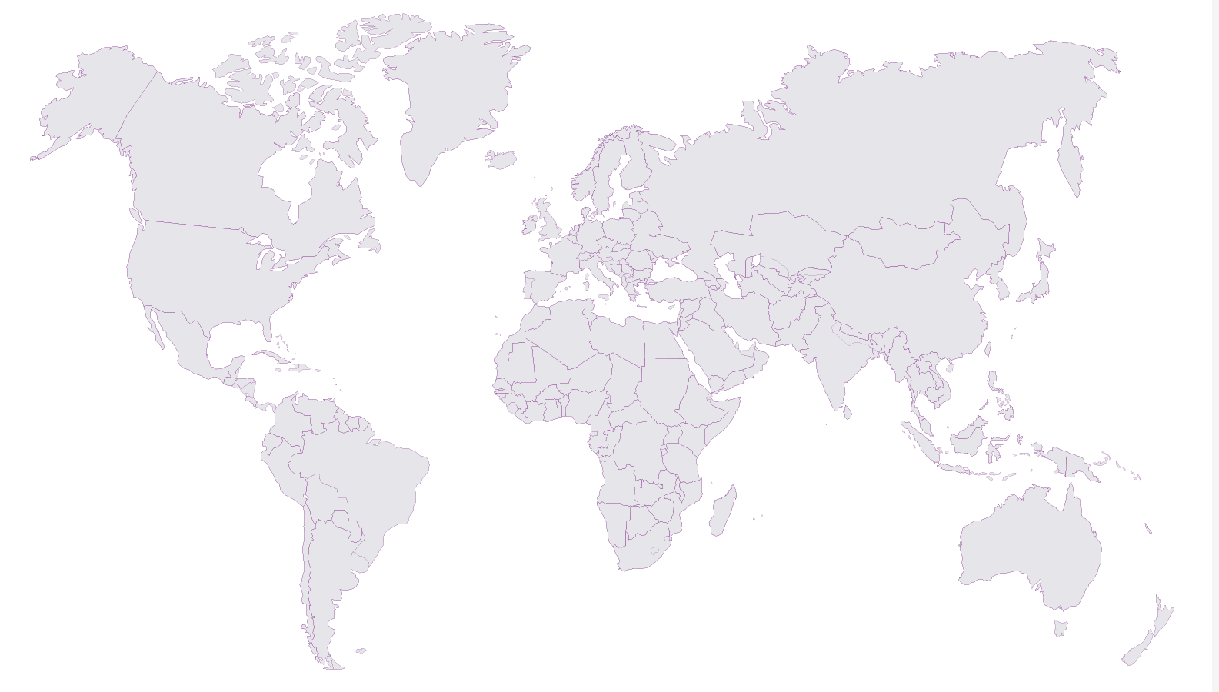
ADULT CHRISTIAN FORMATION
Global Crisis
Refugee-producing
Refugee hosting
Refugee resettlement
Notes:
Thinking about this global displacement crisis, we need to look closer to understand which countries produce refugees and other forcibly displaced people, which countries host displaced people (often on a temporary basis), and which countries allow refugees to resettle permanently. You may be surprised to learn which countries play some of these roles.

Slide 17
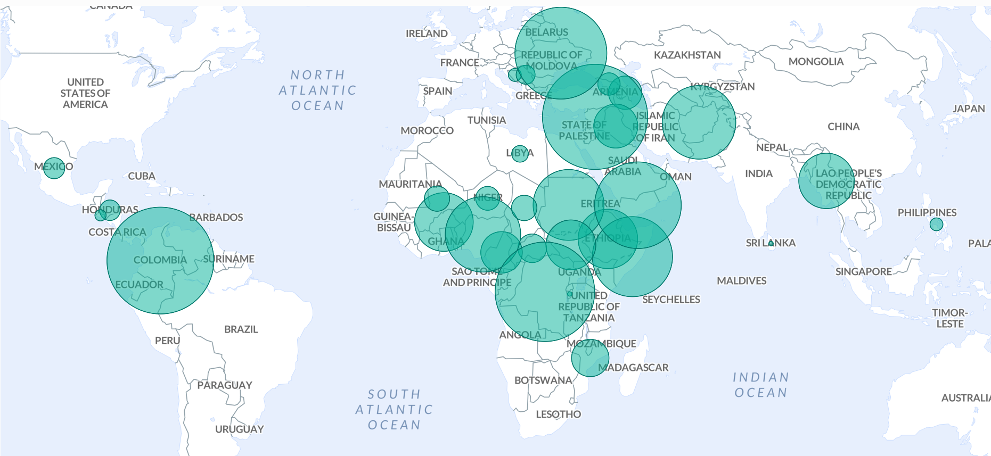
ADULT CHRISTIAN FORMATION
Global Crisis: Internally Displaced Persons
Source: UNHCR Refugee Statistics for mid-2023
Notes:
Here we see the countries with the largest internally-displaced populations recognized by the UN. Can you identify the countries under any of the largest circles? Among those with the largest population of IDPs in 2023 are Colombia (which has taken in millions from Venezuela), Syria, the Democratic Republic of the Congo, Ukraine, Yemen, Somalia and Afghanistan.

Slide 18
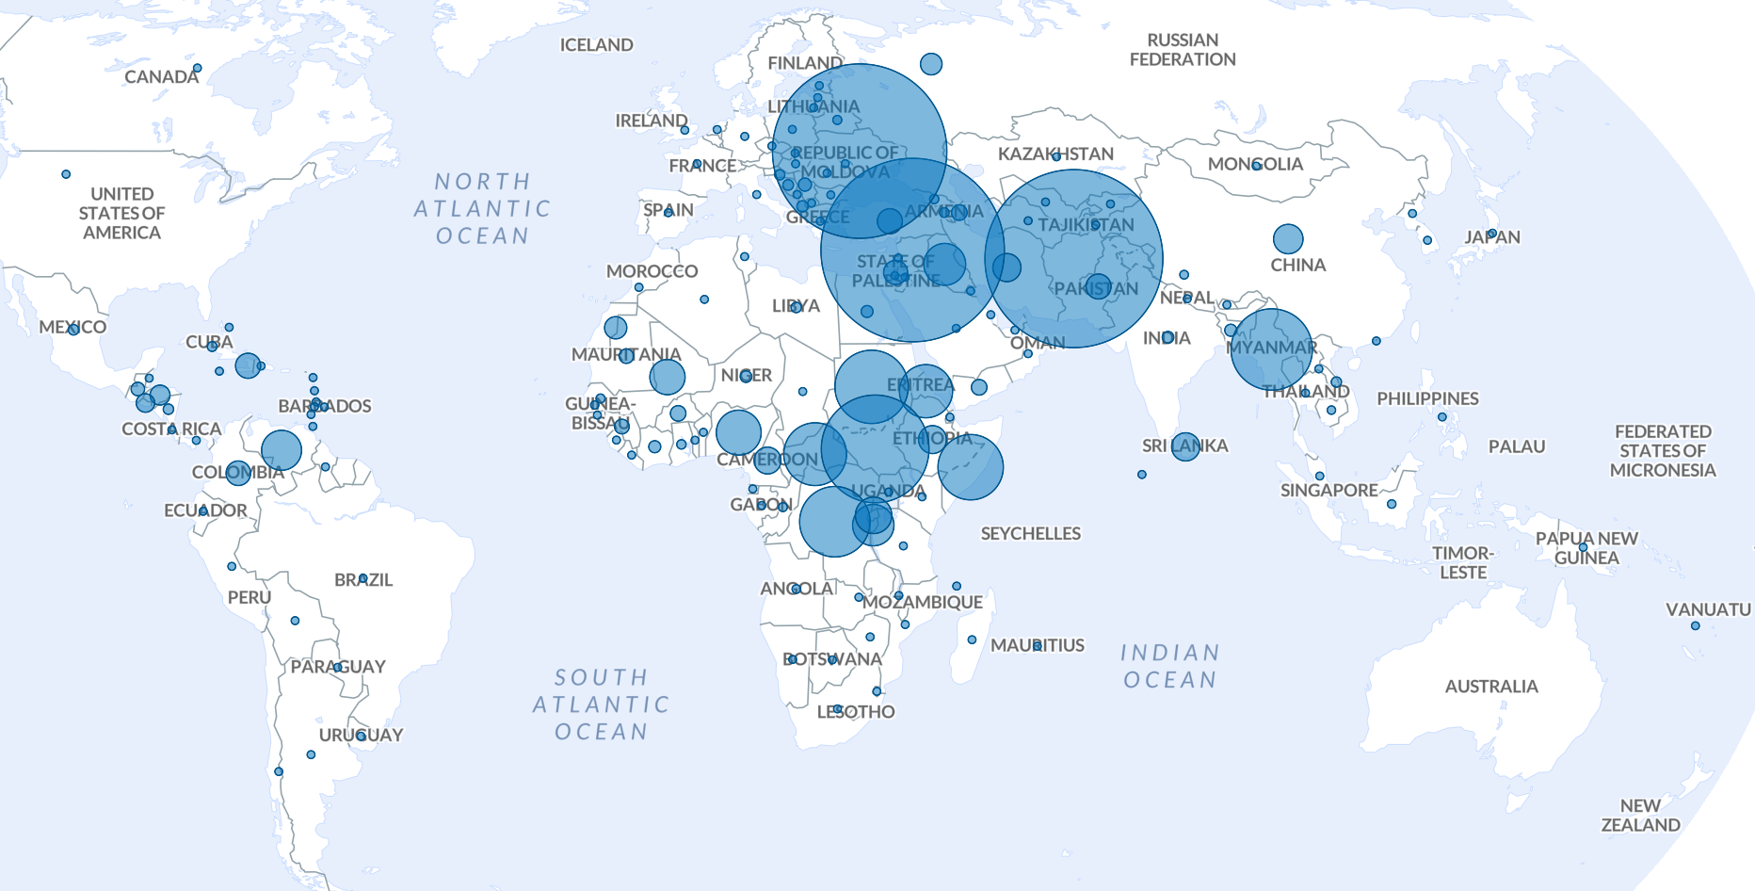
ADULT CHRISTIAN FORMATION
Global Crisis: Refugees
Source: UNHCR Refugee Statistics for mid-2023
Notes:
Here we see the countries that have produced the most refugees in 2023. Can you identify the countries under any of the largest circles? Among those who have produced the largest numbers of people recognized as refugees in 2023 are Ukraine, Syria, Afghanistan, and the Democratic Republic of the Congo.

Slide 19
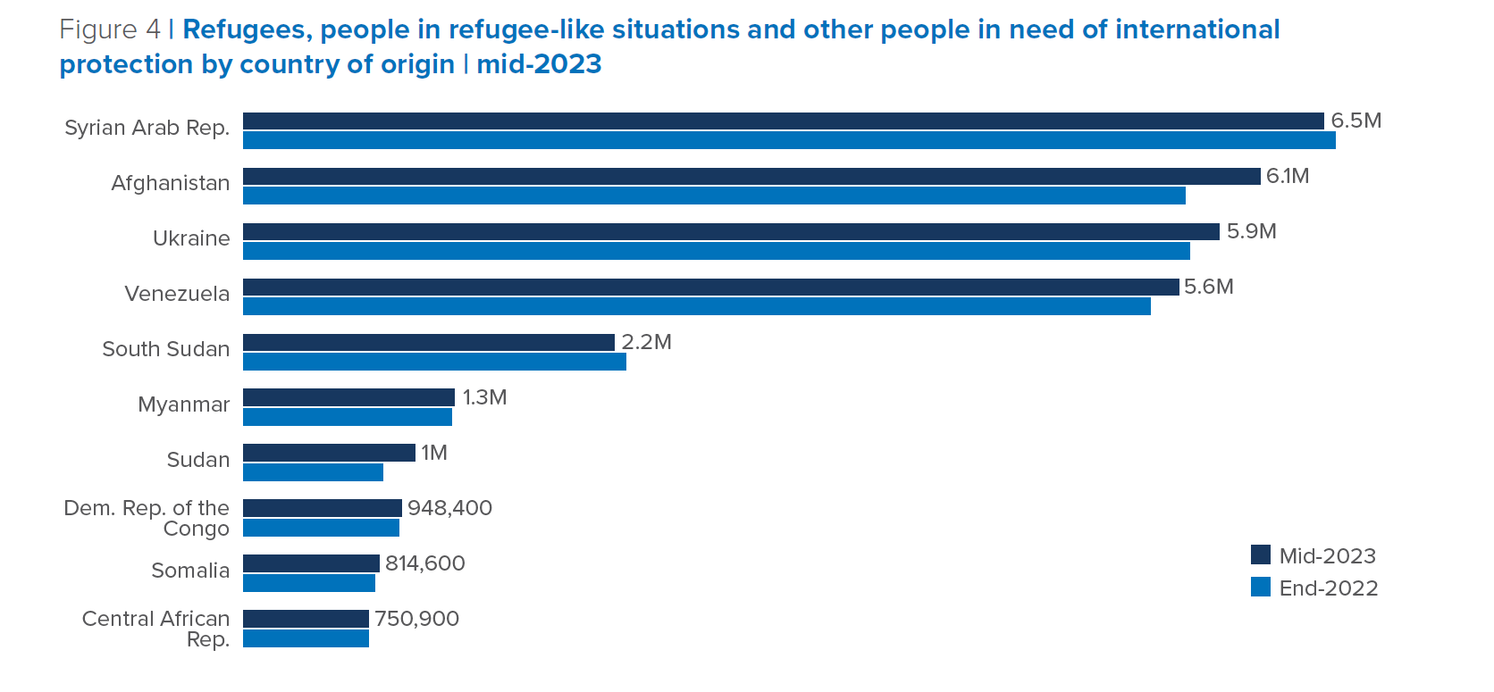
ADULT CHRISTIAN FORMATION
Global Crisis: Refugees
Source: UNHCR Mid-year Trends 2023
Notes:
Here’s another way to look at the figures about where the largest numbers of refugees and other people in need of international protection have come from, in 2022 and 2023.

Slide 20
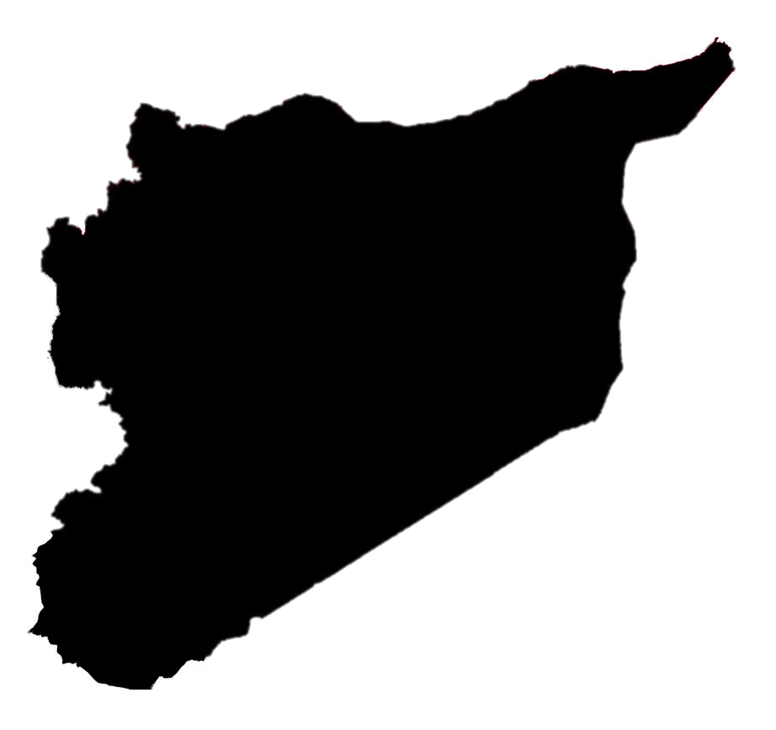
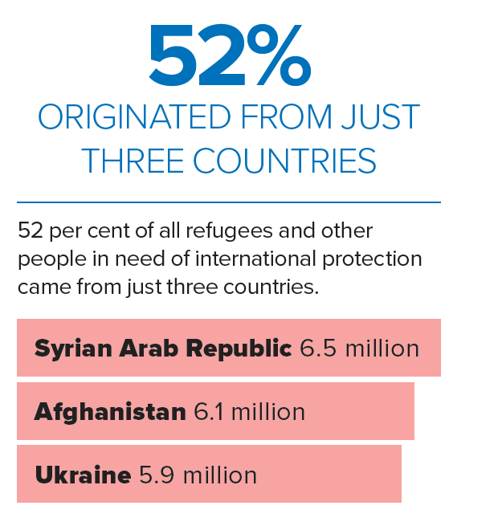
ADULT CHRISTIAN FORMATION
Global Crisis: Refugee-Producing Countries
Source: UNHCR Mid-year Trends 2023
Notes:
More than half of the world’s refugees in 2023 have fled from just three countries: Syria, Afghanistan, and Ukraine.

Slide 21
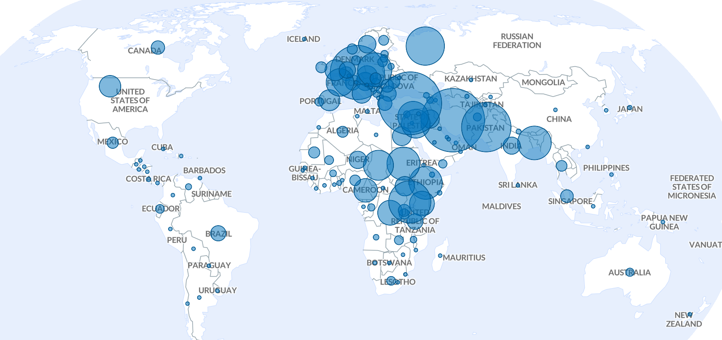
ADULT CHRISTIAN FORMATION
Global Crisis: Refugee-Hosting Countries
Source: UNHCR Refugee Statistics for mid-2023
Notes:
This map shows the countries that are hosting the world’s refugees. Hosting means admitting displaced people while they apply for asylum and wait for a durable solution. The countries hosting the largest populations of refugees or others in need of international protection in 2023 include Iran and Turkiye, Germany, Colombia and Pakistan. Despite its resources, the U.S. ranks far behind other countries in this regard.

Slide 22
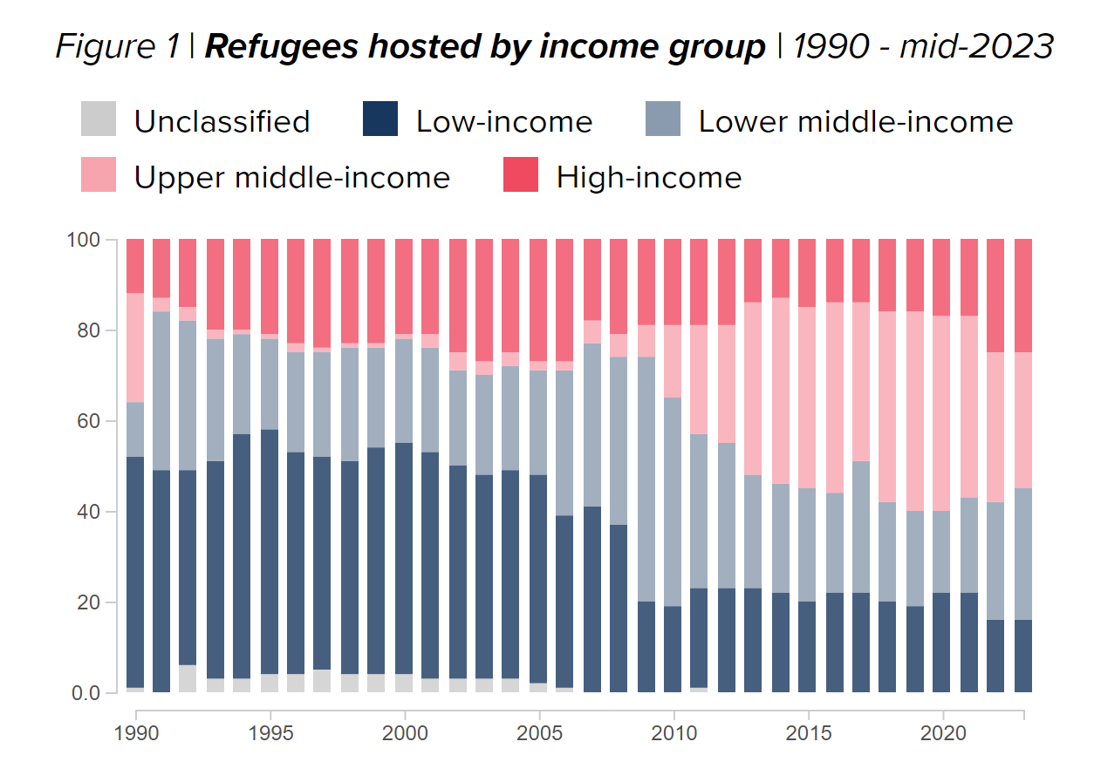
ADULT CHRISTIAN FORMATION
Global Crisis: Refugee-Hosting Countries
Source: UNHCR, Refugee Statistics
Notes:
When forcibly displaced people flee across an international border seeking safety, they are at the mercy of the country to which they’ve fled – for protection, and for adjudication of their asylum claim. While the number of people forced to flee due to persecution, conflict, violence, human rights violations and other causes has continued to rise, three facts have remained relatively consistent over time:
[CONTINUED on NEXT SLIDE]

Slide 23
ADULT CHRISTIAN FORMATION
Global Crisis: Refugee-Hosting Countries
A majority of displaced people are hosted in low- and middle-income countries.
2. Most displaced people seek protection in countries close to their country of origin.
3. Many displaced people remain in exile for protracted periods of time.
.
Notes:
The majority of displaced people are hosted in low- and middle-income countries.
Most displaced people seek protection in countries close to their country of origin.
Many displaced people remain in exile for protracted periods of time.
Low-income countries host a disproportionately large share of the global refugee population, both in terms of their population size and the resources available to them. High-income countries, which account for nearly two-thirds of the global wealth, hosted only 25 per cent of refugees at mid-2023.

Slide 24
ADULT CHRISTIAN FORMATION
Global Crisis
Notes:
The tenuous situations in which refugees find themselves in host countries often drive many to make the desperate decision to attempt a sea crossing to Europe or to Australia. I’m sure many of you have seen the devastating photo of Aylan Kurdi, the Syrian toddler whose body washed up on a beach in Turkey in the fall of 2015.
As the British-Somali Poet Warsan Shire writes in the poem, Home, “you have to understand, that no one puts their children in a boat unless the water is safer than the land.”

Slide 25
ADULT CHRISTIAN FORMATION
Durable Solutions
Repatriation
Integration
Resettlement
Eligible categories
Legal and/or Physical Protection Needs
Survivors of Torture and/or Violence
Medical Needs
Women and Girls at Risk
Family Reunification
Children and Adolescents at Risk
Lack of Foreseeable Alternative Durable Solutions
Notes:
There are three, what are called, durable solutions which the United Nations Refugee Agency is charged with securing for refugees. These are:
Voluntary repatriation to his/her home country;
Local integration into the country of first asylum;
Resettlement to a third country.
Resettlement is the option of last resort for refugees, after it is clear that voluntary repatriation and local integration are not possible. Resettlement is only possible for refugees who fall into the following eligibility categories:
Legal and/or Physical Protection Needs
Survivors of Torture and/or Violence
Medical Needs
Women and Girls at Risk
Family Reunification
Children and Adolescents at Risk
Lack of Foreseeable Alternative Durable Solutions

Slide 26
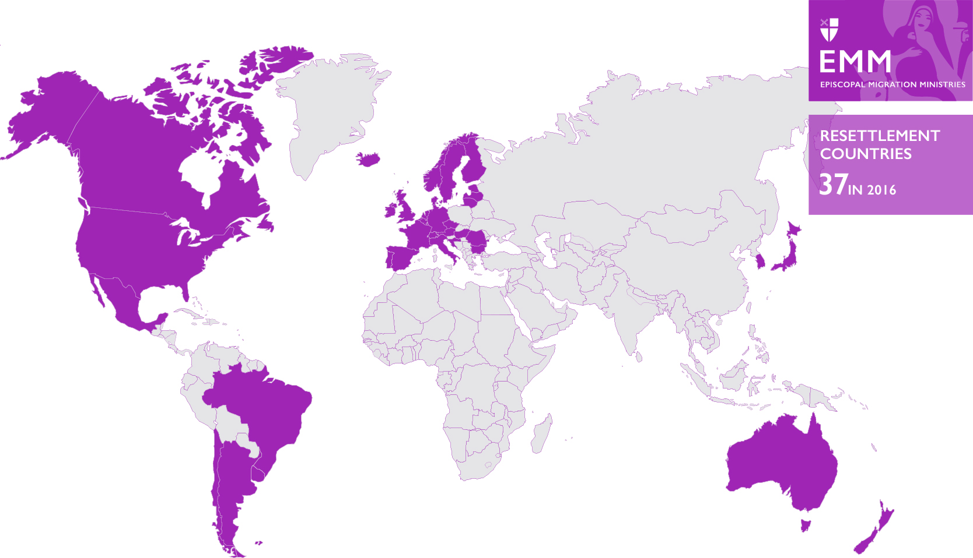
ADULT CHRISTIAN FORMATION
Refugee Resettlement Countries
Notes:
In 2016, only 37 countries participated in the UN resettlement program and accepted quotas of refugees on an annual basis through resettlement or humanitarian admission. The number fluctuates from year to year, but is about the same today.

Slide 27
ADULT CHRISTIAN FORMATION
Refugee Resettlement Countries
Argentina, Australia, Belgium, Brazil, Bulgaria, Canada, Croatia, Denmark, Estonia, Finland, France, Germany, Iceland, Ireland, Italy, Japan, Lithuania, Luxembourg, Malta, Netherlands, New Zealand, Norway, Portugal, Rep. of Korea, Romania, Spain, Sweden, Switzerland, United Kingdom, United States, Uruguay
Notes:
Since 2019, these (31) countries have resettled refugees through the UNHCR.
There is much more need of resettlement than there are resettlement spots available; the United Nations estimates that roughly 2 million refugees are eligible for resettlement per the eligibility categories above. However, less than 1% of the world’s refugees will ever be resettled because there are too few spots available.
After the UN Refugee Agency refers those eligible for resettlement to one of the participating countries, processing of each case continues according to the system set up within that country.

Slide 28
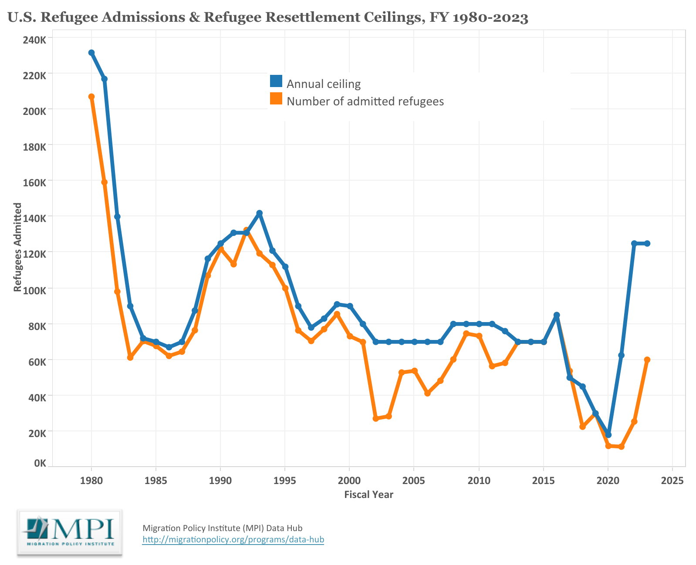
ADULT CHRISTIAN FORMATION
United States Refugee Admissions Program (USRAP)
Notes:
Refugees who are referred to the United States for admissions and approved for resettlement arrive through what is called the United States Refugee Admissions Program, or USRAP. The USRAP was created in 1980 by a piece of legislation called the Refugee Act, signed into law by President Jimmy Carter. The program had longstanding bipartisan support until 2016. Under the Trump administration, annual refugee admissions were severely restricted. However, admissions and support for the program in the U.S. have rebounded since 2021.

Slide 29
ADULT CHRISTIAN FORMATION
United States Refugee Admissions Program (USRAP)
Notes:
The USRAP is both an international and domestic interagency effort and public-private partnership, involving a number of governmental and non-governmental partners both overseas and in the United States.

Slide 30
ADULT CHRISTIAN FORMATION
Video

Slide 31
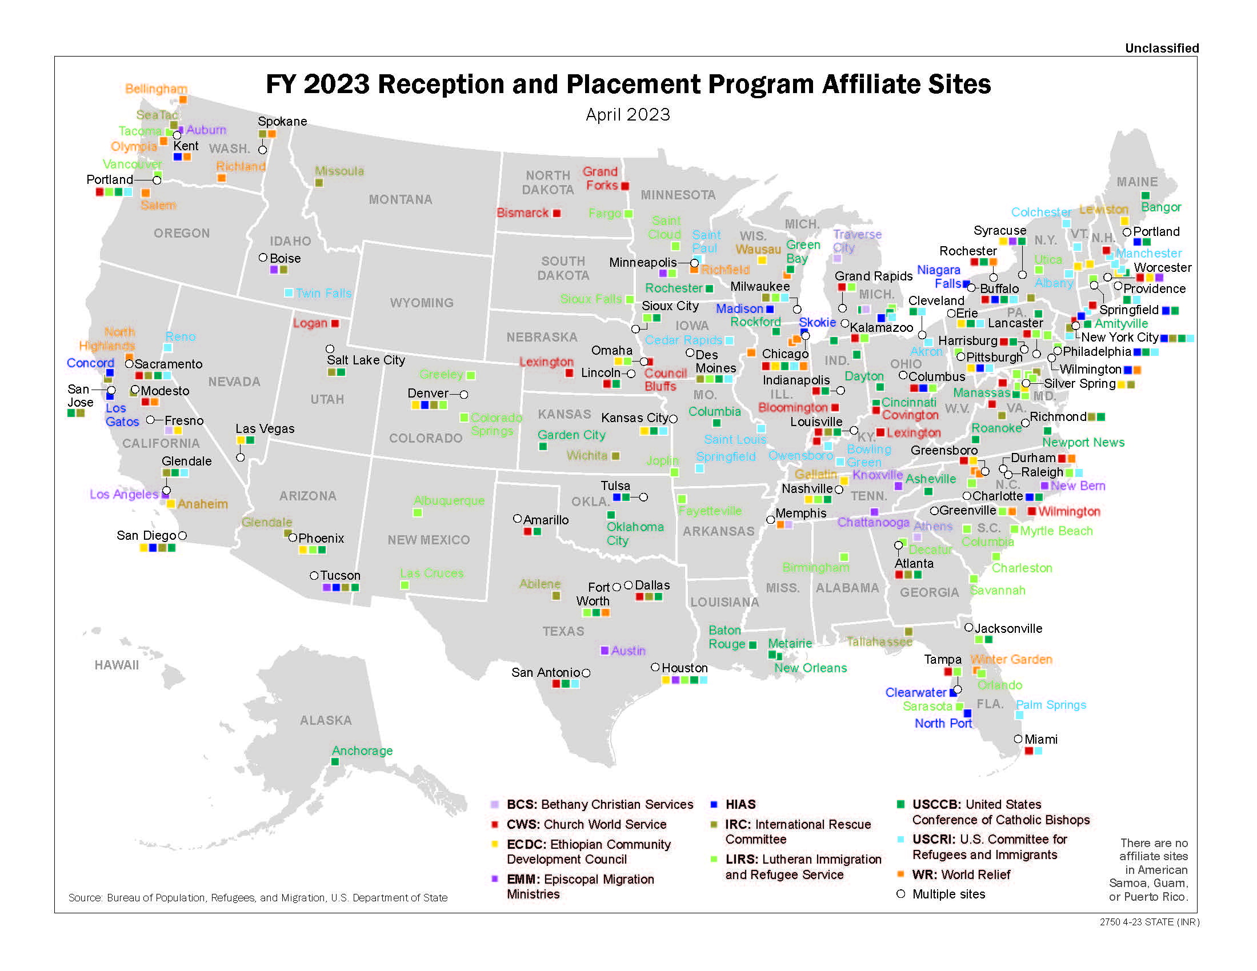
Notes:
There are now ten national agencies that contract with the federal government and have local partner offices in communities across the United States. This map shows those local partners in Fiscal Year 2023.

Slide 32
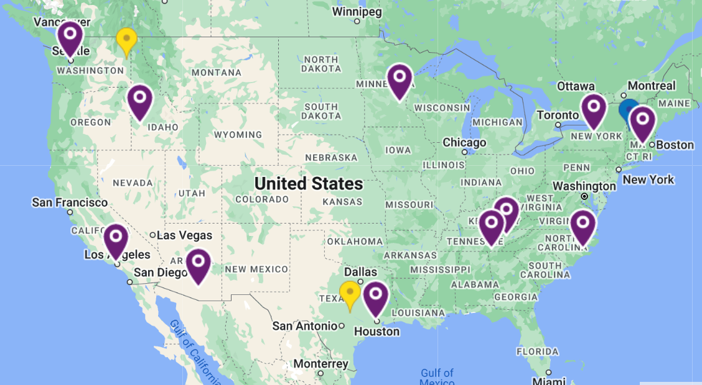
ADULT CHRISTIAN FORMATION
Episcopal Migration Ministries’ Resettlement Partners
Notes:
Episcopal Migration Ministries currently has 13 local affiliates engaged in comprehensive refugee resettlement plus three community partners who provide one or more specific programs. In the weeks to come, we’ll learn more about their work, the ways we can help and support them, and other opportunities to be involved in Episcopal Migration Ministries’ work of welcome.

Slide 33
ADULT CHRISTIAN FORMATION
Discussion
What did you learn that you didn’t already know?
What surprised you?

